Slide 1
Power BI apps on Business Central environment/app telemetry
April 2023 release

Slide 2
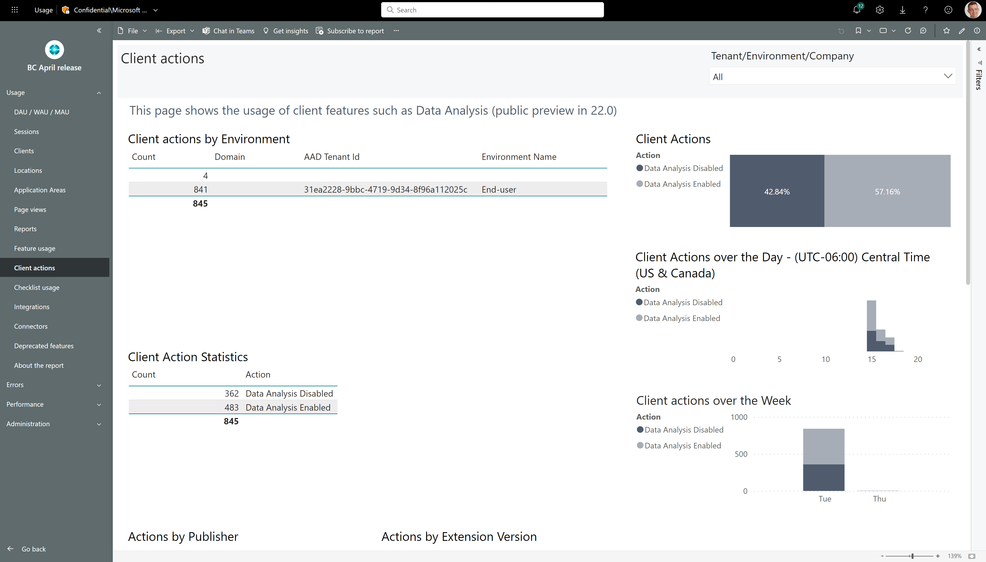
New page: Client actions

Slide 3
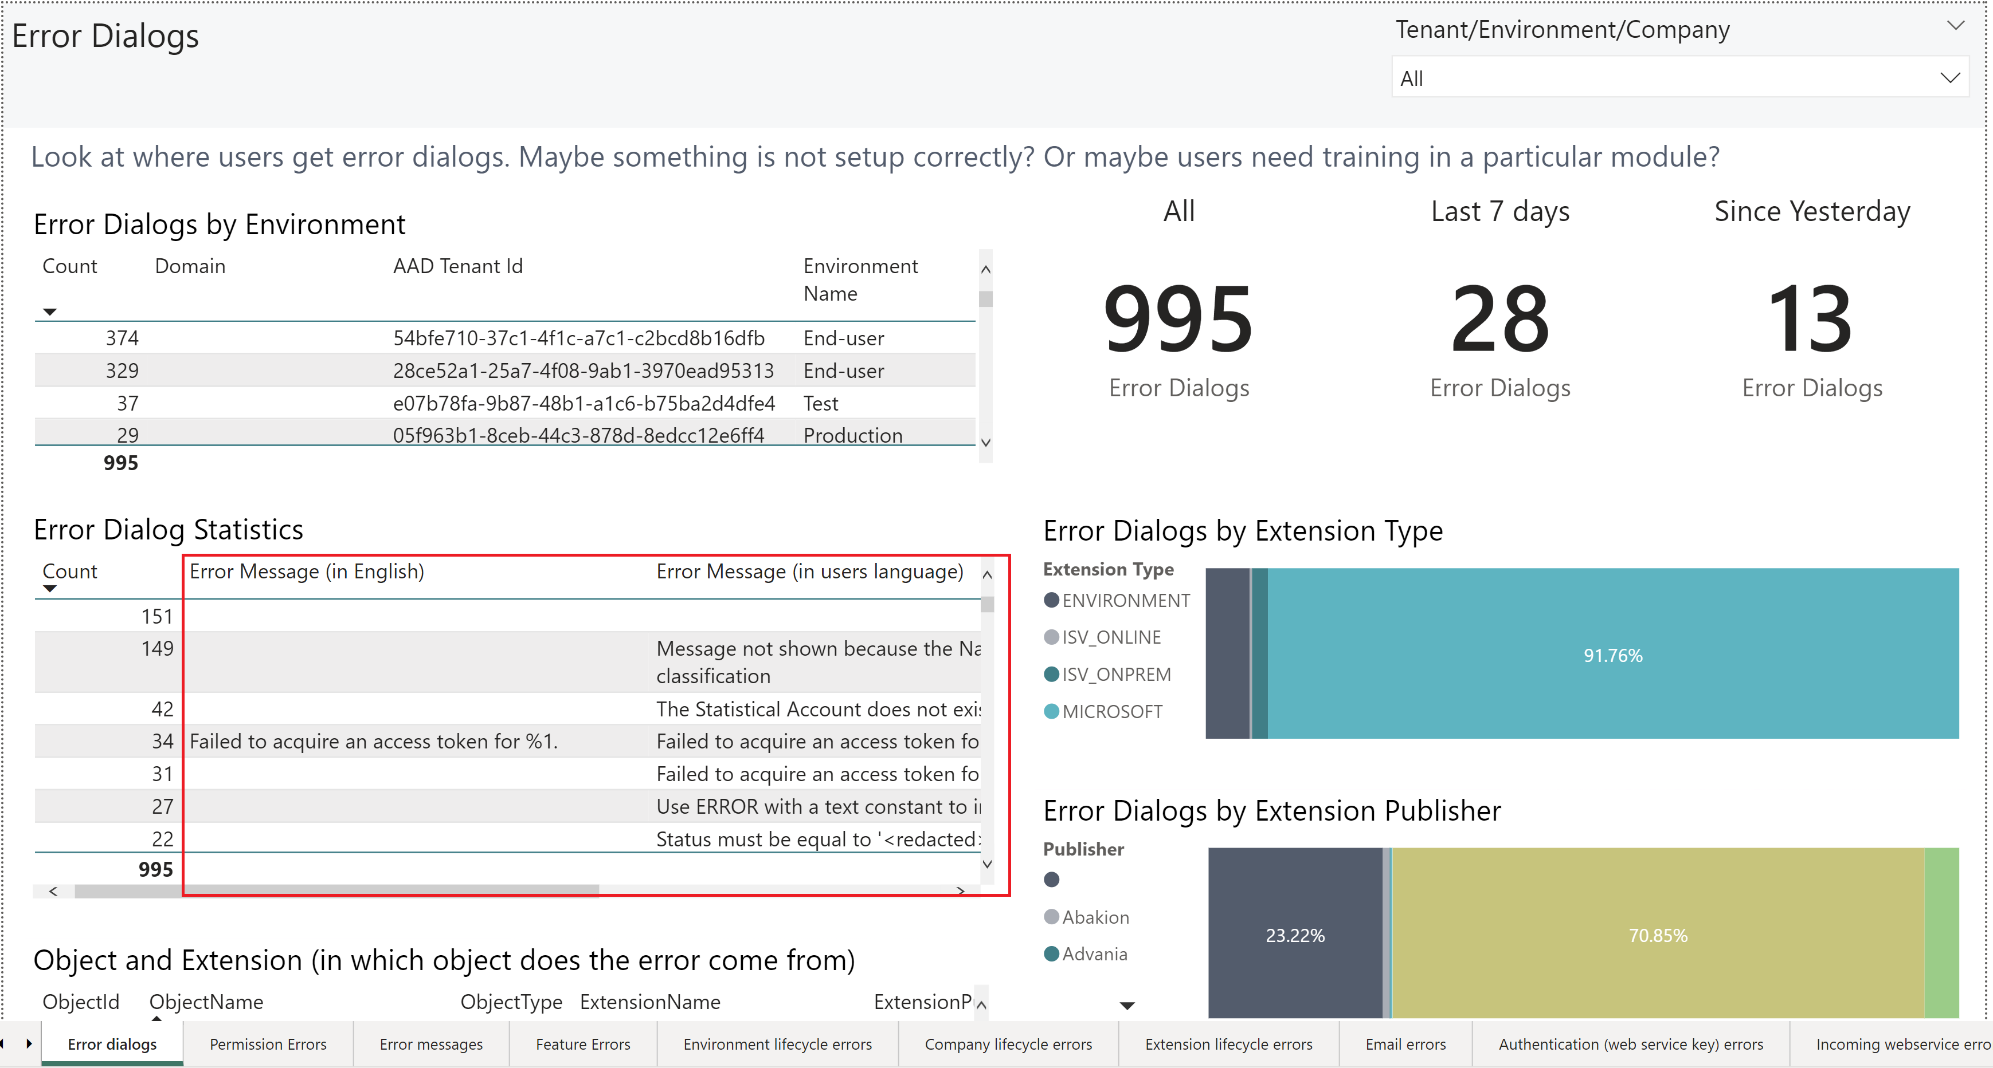
Errors also shown in English language

Slide 4
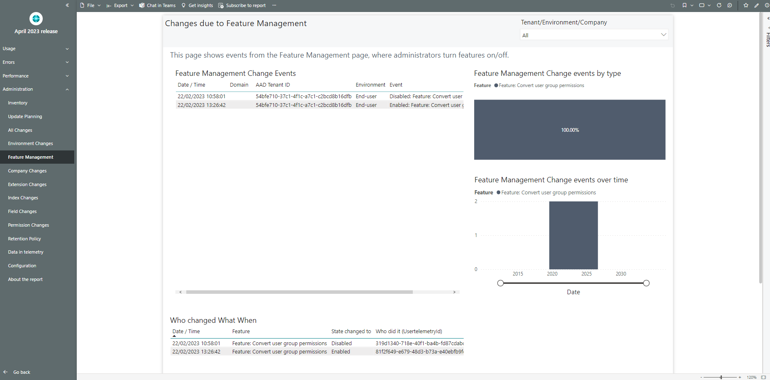
New page: Feature Management

Slide 5
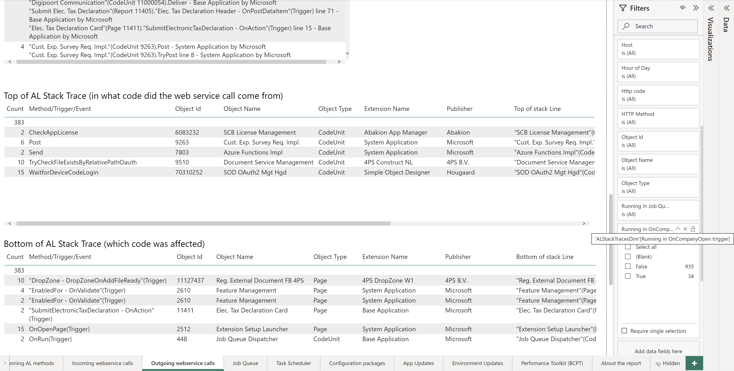
Outgoing ws calls in login triggers

Slide 6
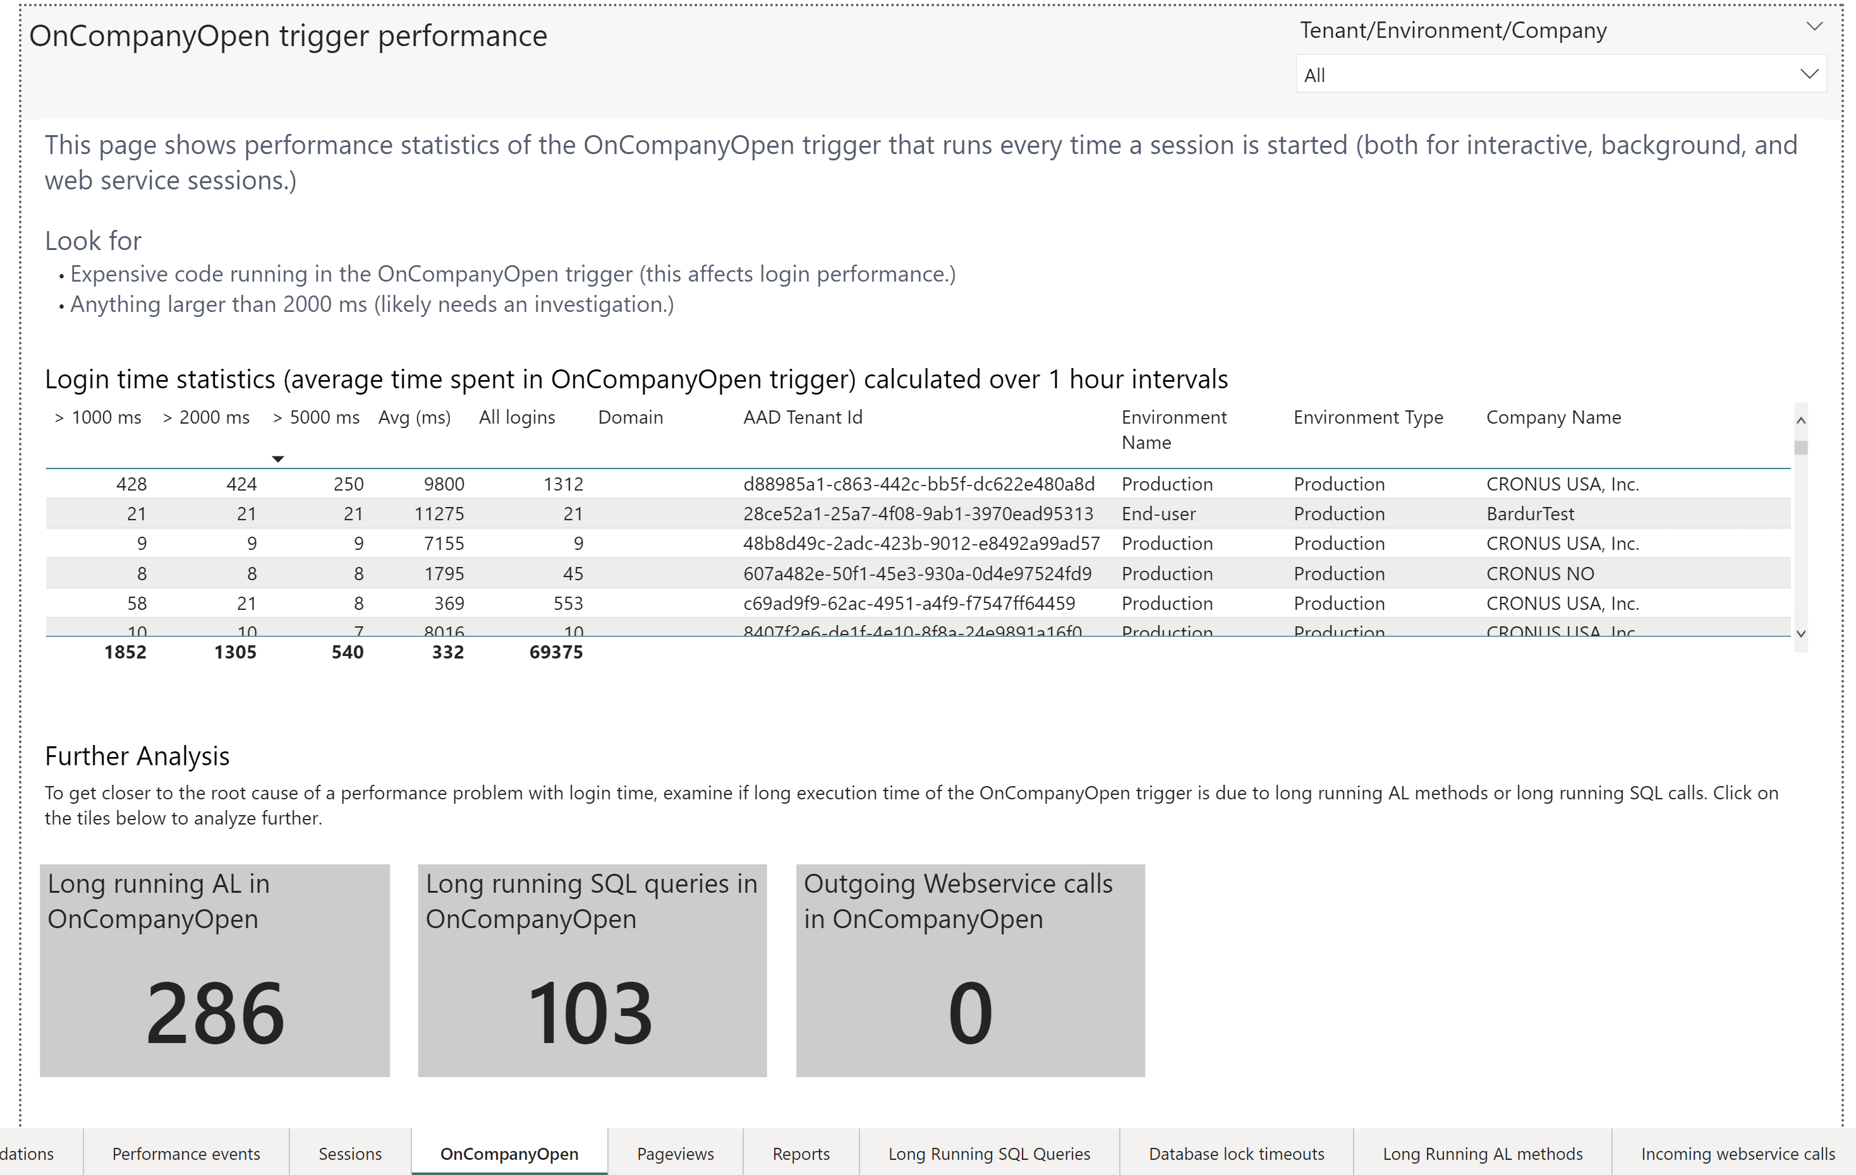
Outgoing ws calls in login triggers

Slide 7
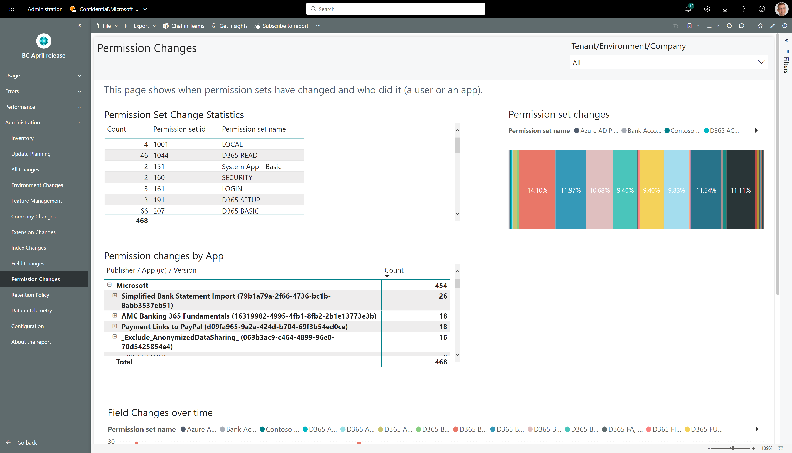
New page: permission changes

Slide 8
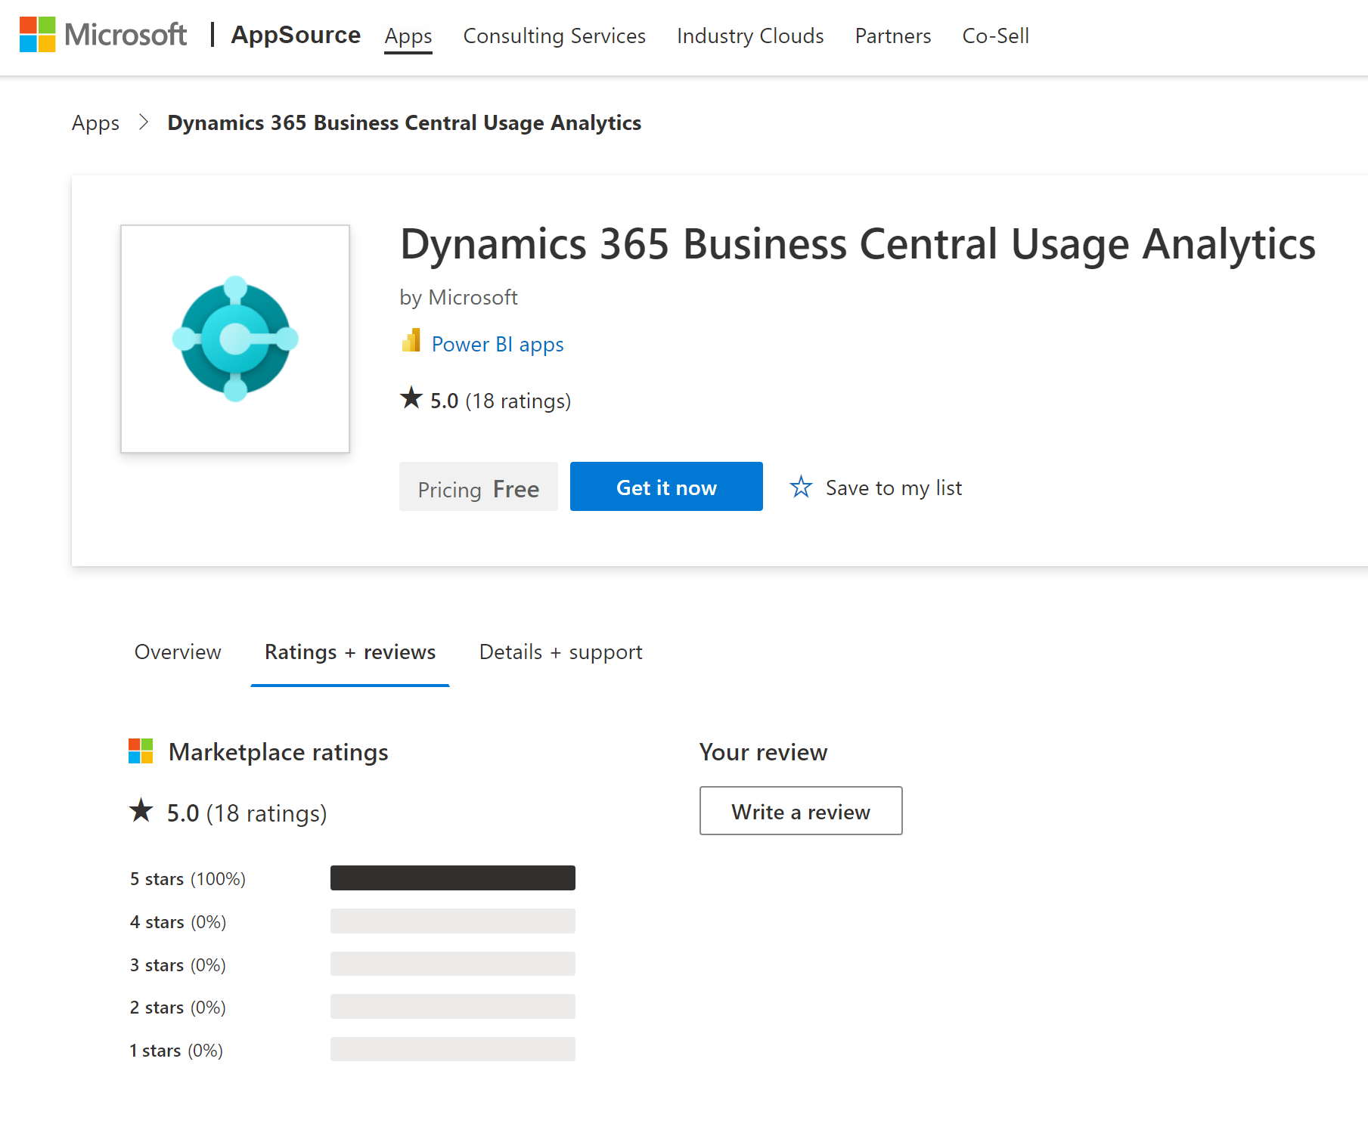
Install/update from Appsource (available now)

Slide 9
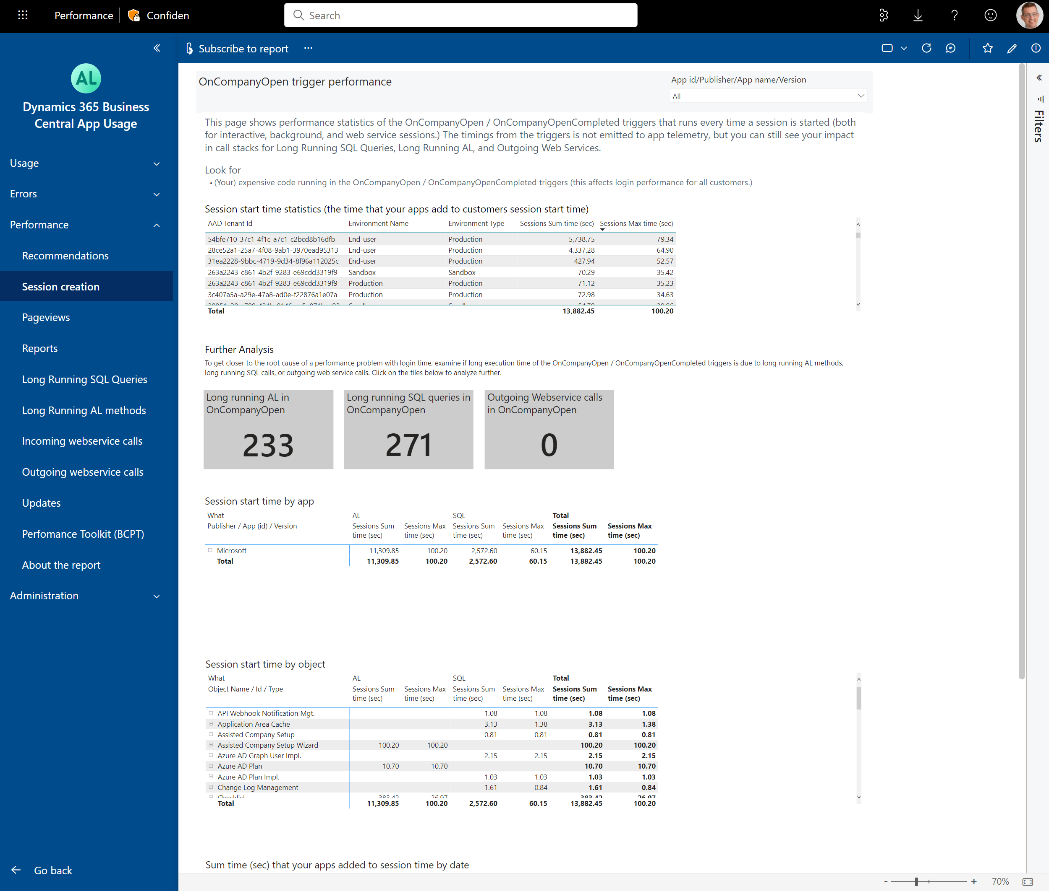
New page: session creation (for ISV app)

Slide 10
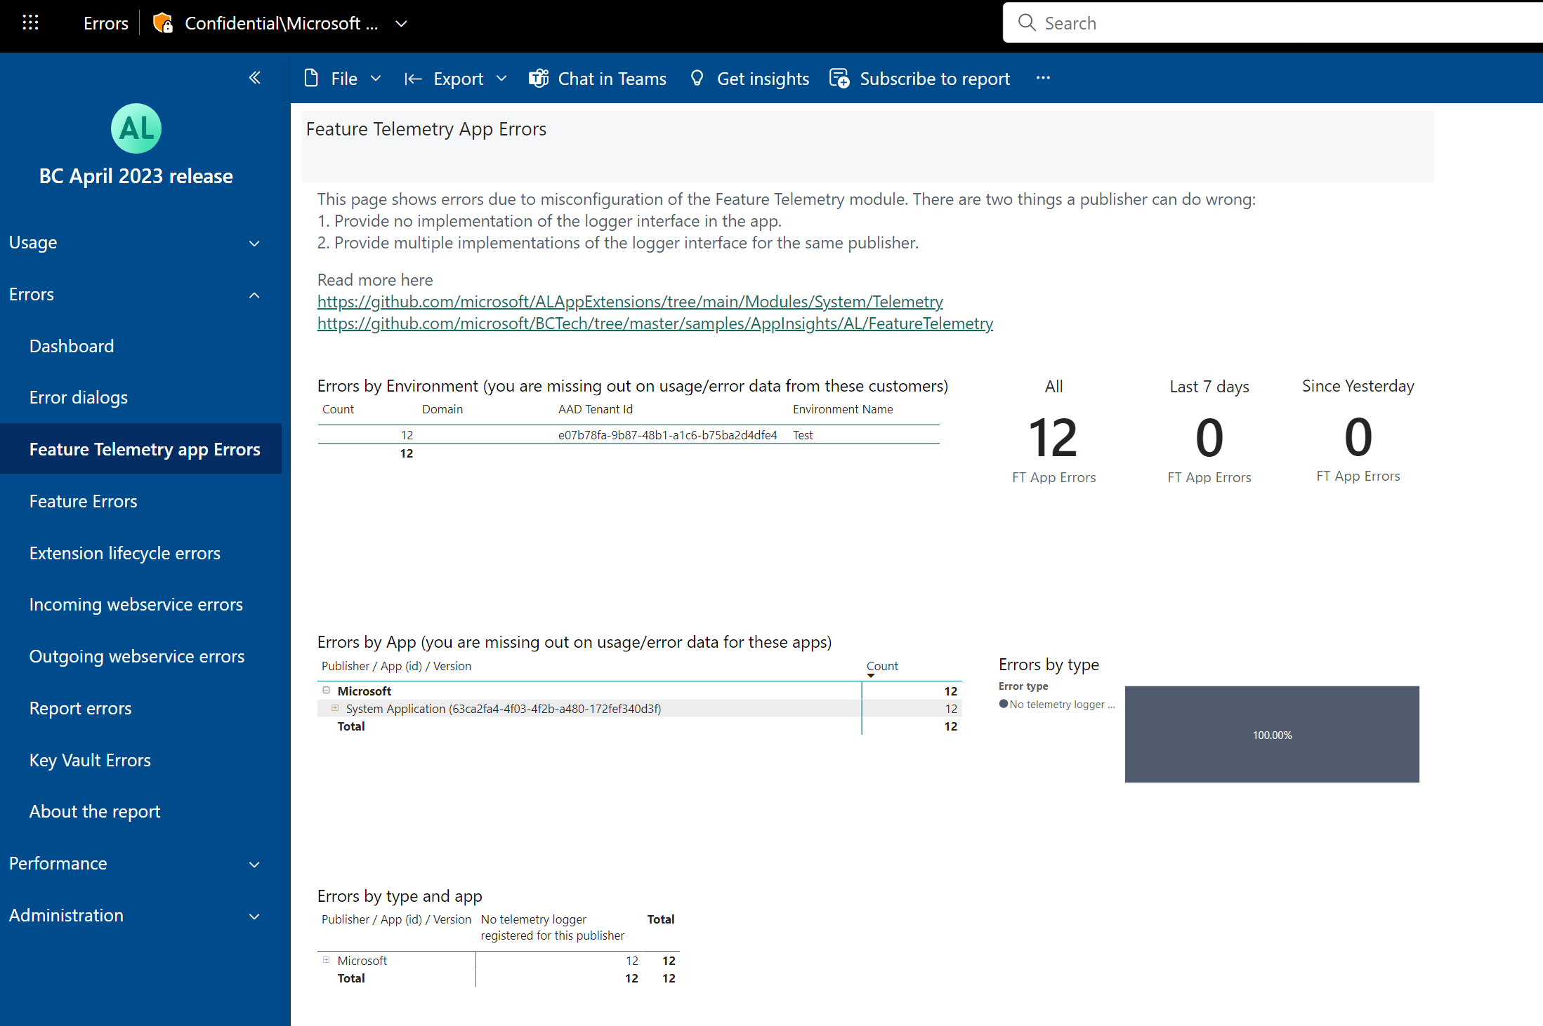
New page: Feature telemetry setup errors (for ISV app)

Slide 11
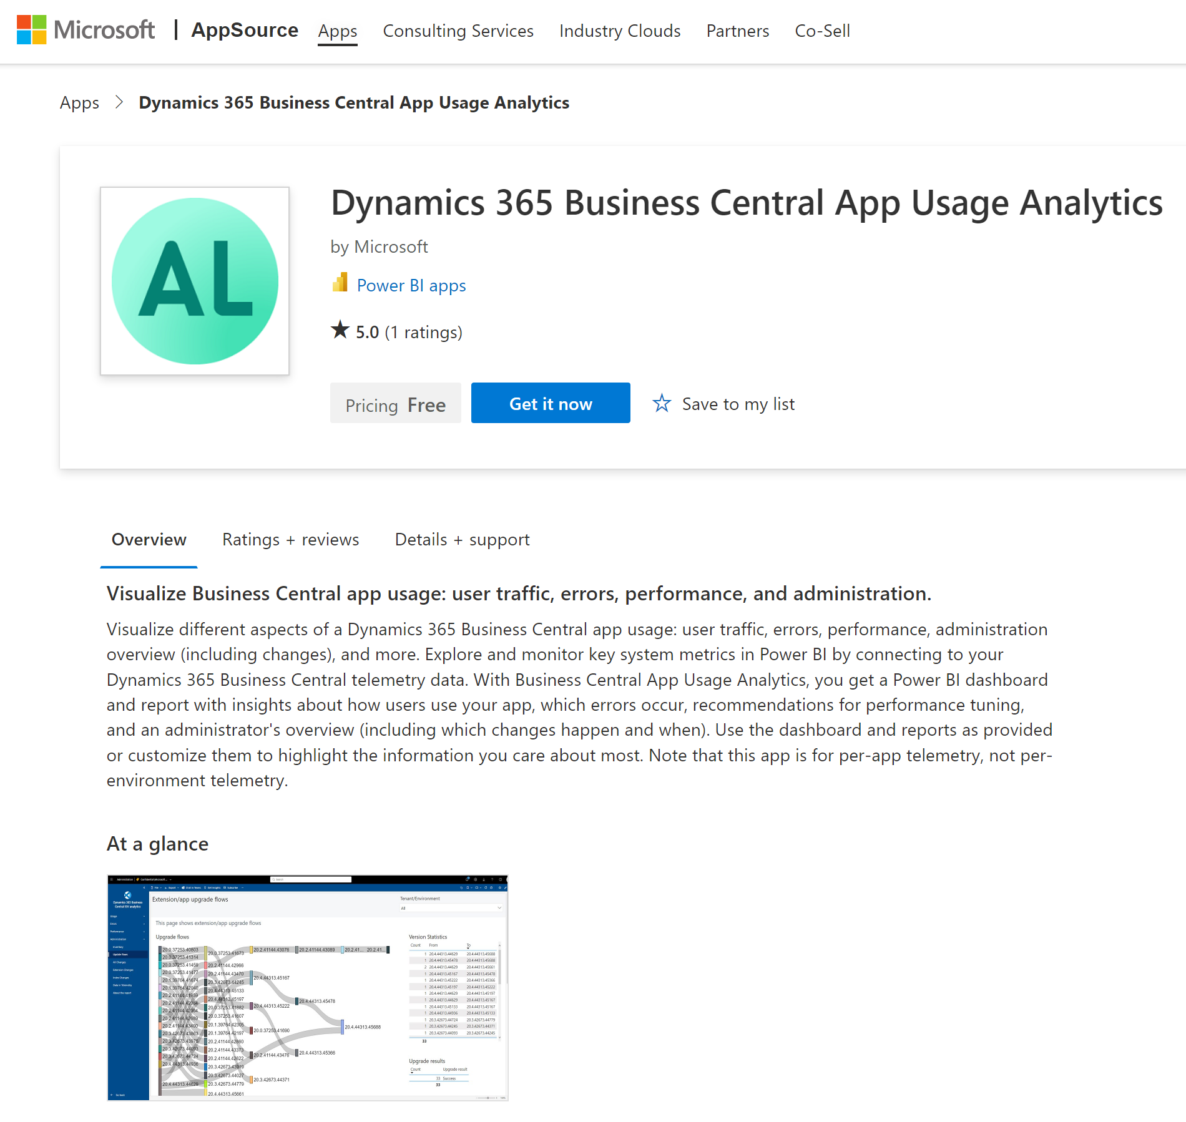
Install/update from Appsource (available now)

